Slide 1
Jumia Business Case
Presented By : MADJID ERROUKRMA
Date : 11 / 10 / 2022

Slide 2
CONTENT
INTRODUCTION
FIRST PROBLEM
SECOND PROBLEM
THIRD PROBLEM
FOURTH PROBLEM
GUIDING THE CAMPAIGN
TOOLS USED
TECHNICAL PROCESS

Slide 3
INTRODUCTION

Slide 4
INTRODUCTION
In the modern wold data is used to indetify themes , spot unusal patterns , categorize things & guide Business strategies
The guide of this analysis is to understand customer data , extract insights through a technical process and give recommendations to guide Jumia’s Marketing strategy
To do that we must define the problem through asking the right questions

Slide 5
PROBLEM 1
Q : Who are the top 10 clients in terms of Number of Ordered items ?

Slide 6
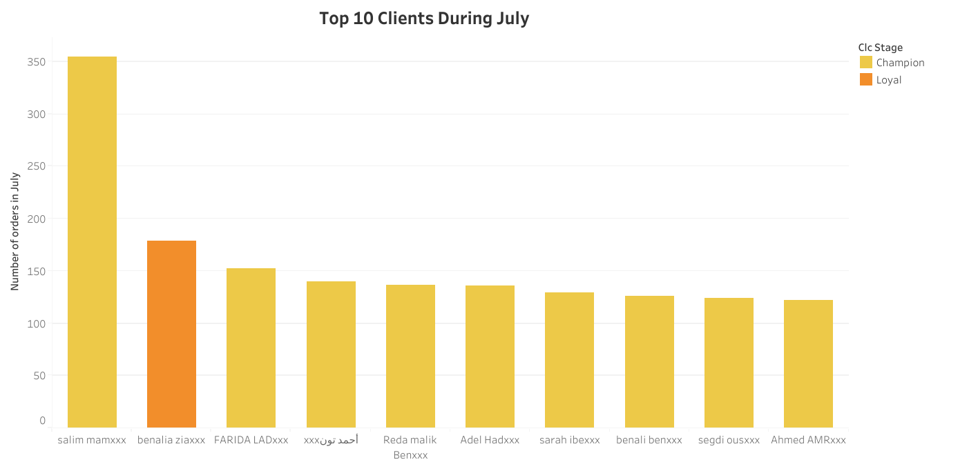
Graph Interpretation
The graph represents top 10 clients with the most number of orders , as we can see 355 order is achieved by the 1# Client , all the clients are ‘champion’ except for the second client which is a ‘Loyal’ , all contact infromation of these clients are Known.

Slide 7
PROBLEM 2
Q2 : What is the Proportion of the ‘Loyal’ Customer Segment in July?

Slide 8
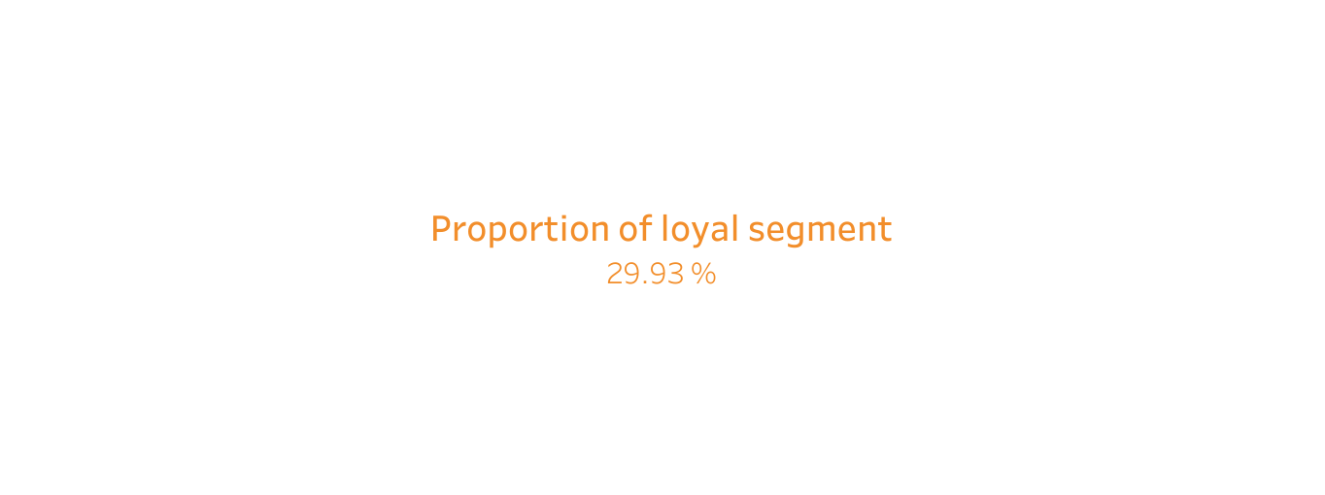
Graph Interpretation
The ‘Loyal’ Customer Segment represents 30 % of the Customer Segment in July.

Slide 9
Problem 3
Q : Which Customer segment Consumed More Voucher ?

Slide 10
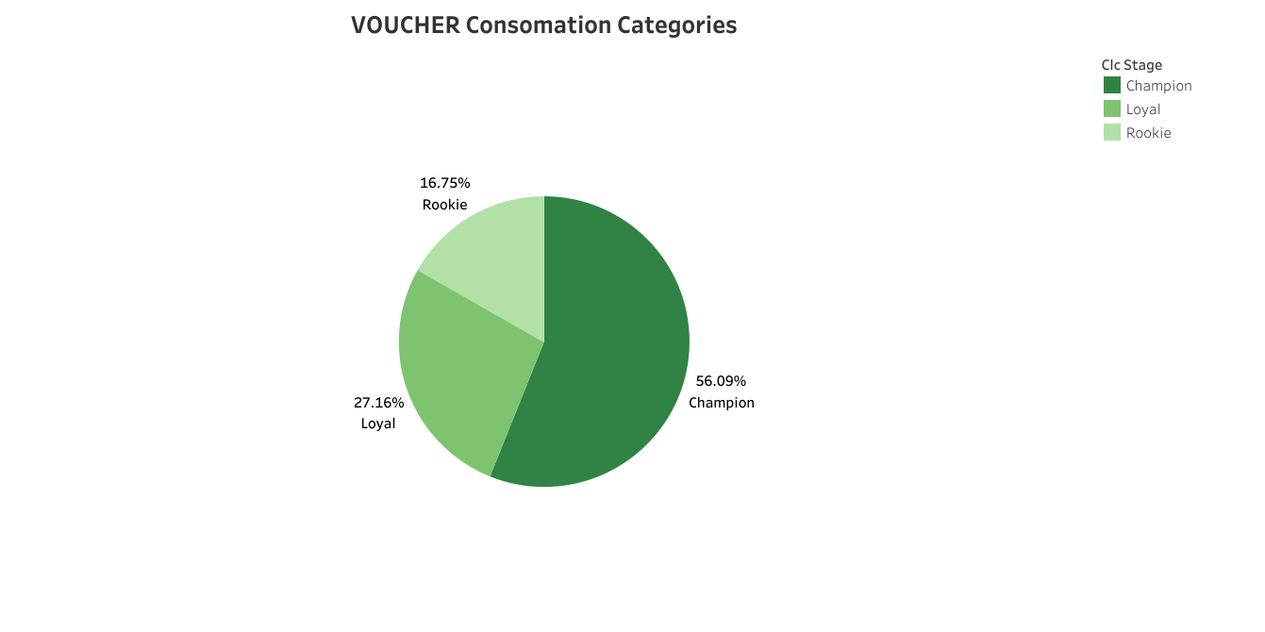
Graph Interpretation
As we can see from the pie chart , the ‘Champion’ Customer Segment Consumed more Voucher up to 56% of total vouchers , Followed By ‘Loyal’ Customer Segment with a percentage of 27% of total Vouchers

Slide 11
PROBLEM 4
Q1 : Which Marketing Campaign Performed Better ?

Slide 12
Table Interpetation
With a better CTR of 1.89 % and more generated order , it’s Clear to us the the first Campaign of the 1st row , performed much better the second one despite having more advertised (40000 sent)

Slide 13
PROBLEM 4
Q2 : What are the main elements that helped this campaign perform better ?

Slide 14
Table Interpretation
After carefully checking out cmpaign informations we can say that the Short Message & Long Message are the key performenace indicators and we can spot the following things :
Short Message the communicates Deals and Promotions Directly and is precise about the product achieve better CTR
Long Message that short and guide directly to the source of product achieve better CTR
With these 2 Combined We can Boost the Click Number that will lead to more CTR % and that to more Generated orders

Slide 15
PROBLEM 4
Q4 : how to remake the campaigns to achieve better performence ?

Slide 16
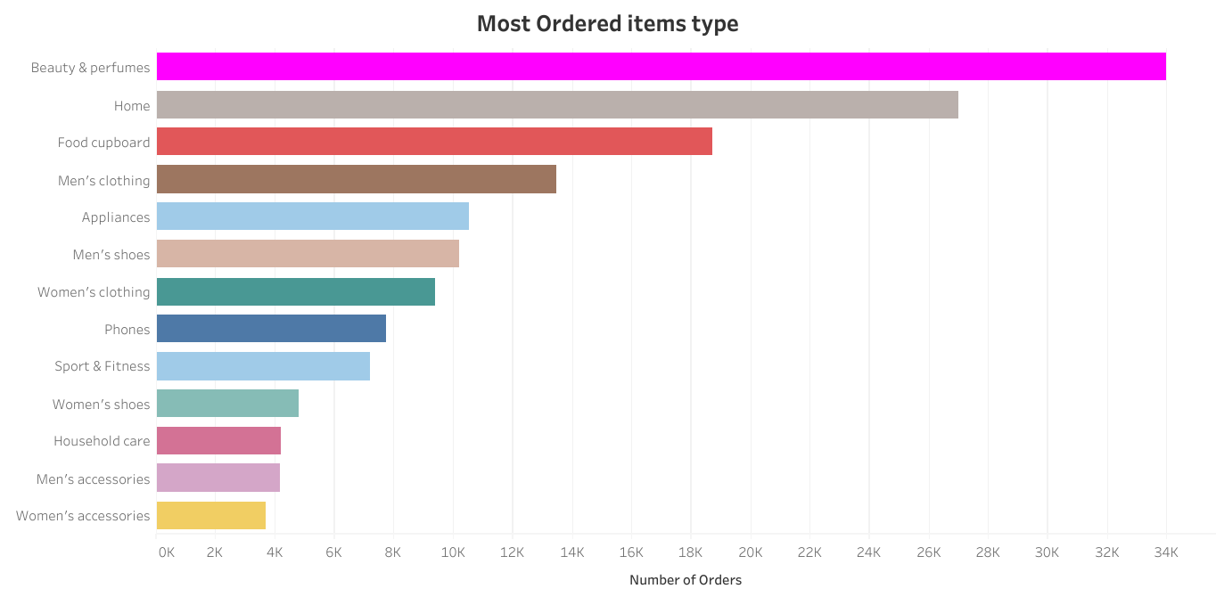
Graph interpretaion
These graphs represents the top 10 most ordered items categoy , targeting campaign using this products will most likely leed to a better performenace

Slide 17
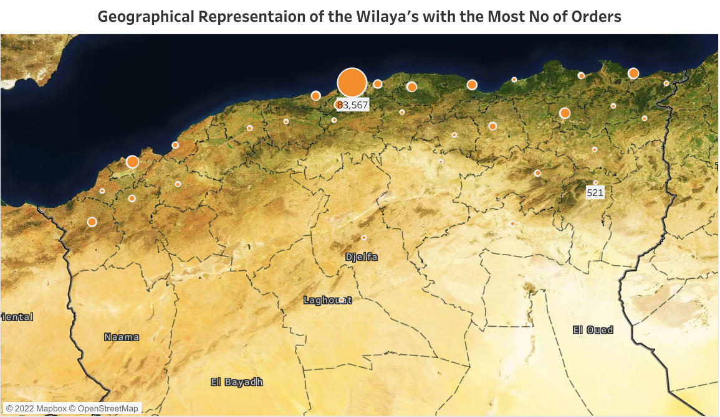
Graph interpretaion
Top Wilayas with the most number of orders , more sent campaigns here will lead to more CTR % , we can notice wilaya’s such as : Algiers ,Blida , Tipaza & Oran

Slide 18
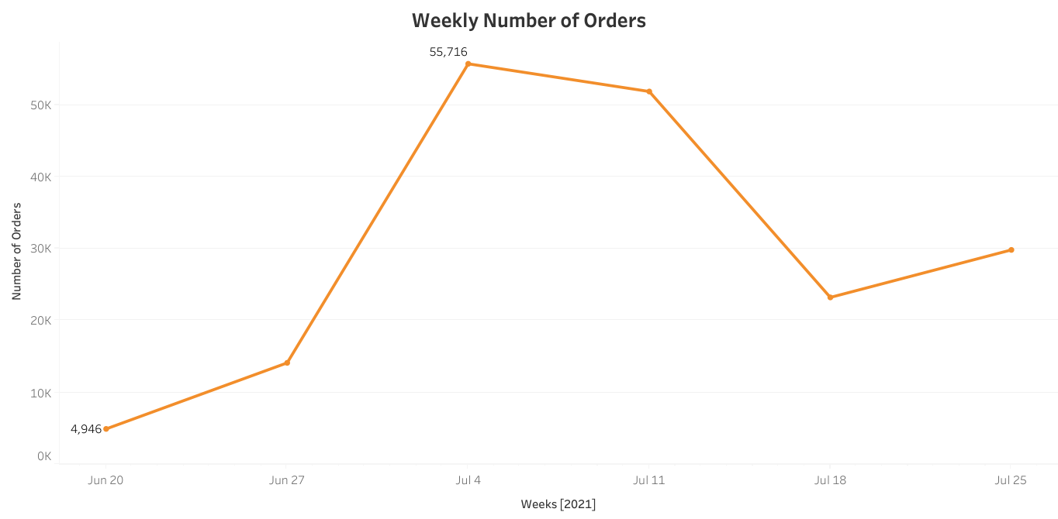
Graph interpretaion
4th of july
Number of orders increase in 4 July , which means people are more likely to buy in that date , with more then 55k + order that day probably because of the indépendance day 5 of july

Slide 19
GUIDING THE CAMPAIGN
To Increase the performenace and according to our data we can :
Send more campaign to Specfic Clients (top Clients)
Specefic Segments ( Champion & Loyal more then Rookies )
Specefic Item categories (such as Beauty & Perfumes , Home )
Specefic Locations ( Algiers , Blida , Tipaza & Oran + others .. . .)
Specific Date such as 4 , 5 of July
Using Precise Short message with Deals and Promotions Mentioned
Using Direct guided Long Messages that leads directly to the source

Slide 20
THANKS FOR YOUR ATTENTION

Slide 21



Tools Used

Slide 22
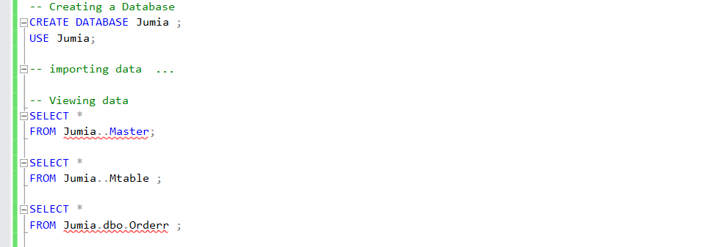
PREPARATION
Viewing data in excel and trying to get a grasp of understanding on the data
Creating a new database
Importing data through wizard and Viewing it again

Slide 23
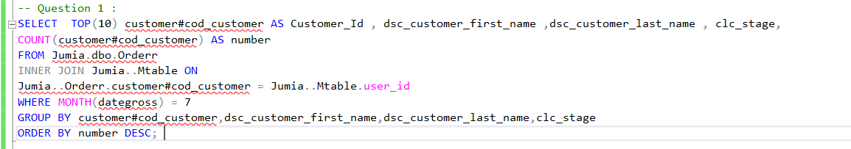
TECHNICAL PROCESS
Used Select to identify Key Columns + Top(10) to get only first 10 results
Joins to match information such as name form both tables
Month(dategross) = 7 to extract the month which is july
Last but not least Group by and order by to Organize the Query

Slide 24
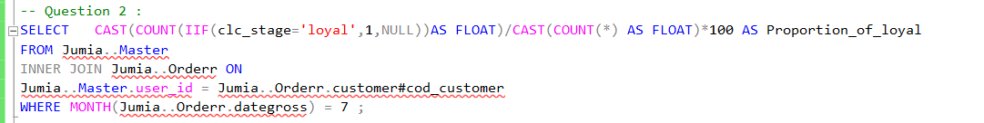
TECHNICAL PROCESS
COUNT(IIF) to count Loyal segment and calculate percentage
Joins to match information such as name form both tables
Month(dategross) = 7 to extract the month which is july

Slide 25
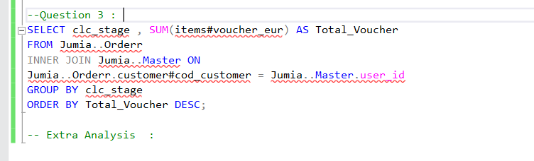
Technical Process
Select and sum to get total vouchers
Joins to match information such as name form both tables
Last but not least Group by and order by to Organize the Query

Slide 26
LAST STEPS
Export the result table into csv a file
Import csv into a brand new excel worksheet
Import worksheets into Tableau for Visualizations
Export Visualizations and Make the Presentation

